Slide 1
Building a Smart home Security System
CEIS101 Final Course Project
May 2025-June 2025
Brandon Johnson
Prof. John Lambrou

Slide 2
Introduction
The overall project of the class was the Building of the Automated Smart home Security System Through a web based program known as TinkerCAD.
The objectives of each weekly project assignment was to Successfully add the correct components to the Arduino board and breadboard. Add proper grounding wires connecting from Breadboard to Arduino board. Then add the corresponding code to initiate simulations and fix any errors that appear through trial of code.
Tools used throughout the project are Microsoft word, Office, Excel and TinkerCAD.

Slide 3
CEIS101
Module 2
Circuit Simulation in Tinkercad

Slide 4
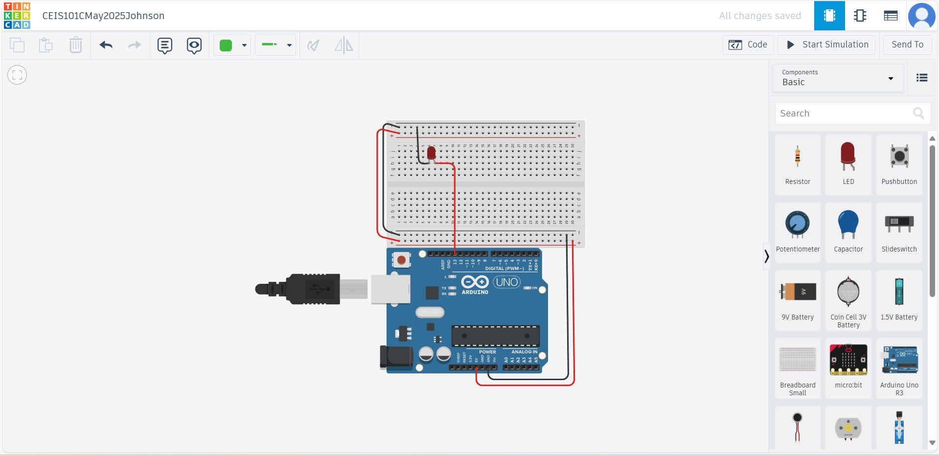
Circuit (Arduino Uno screenshot)

Slide 5
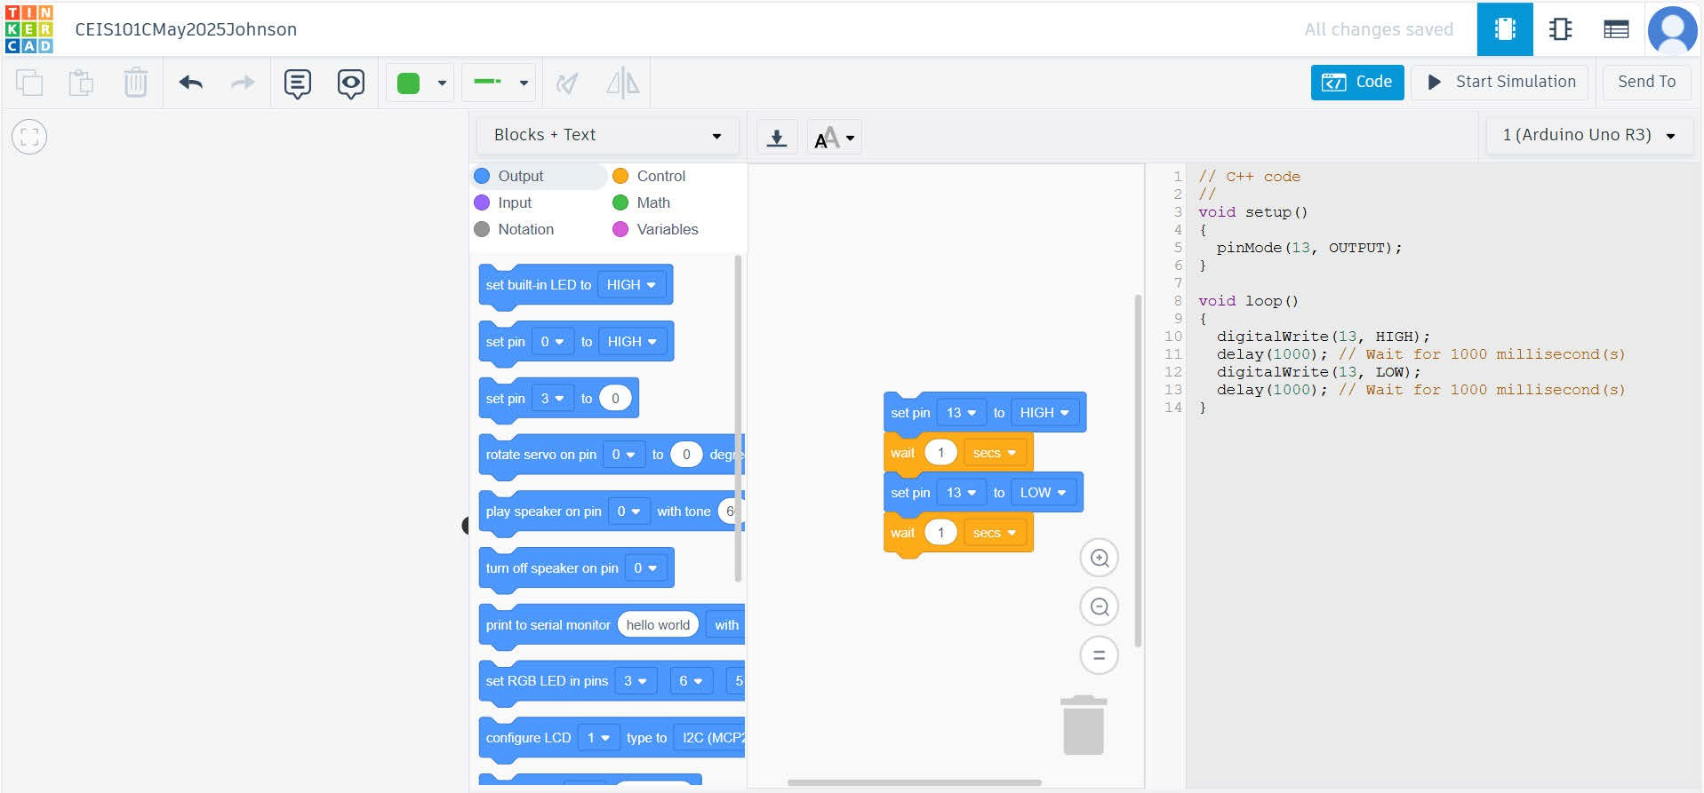
Code Block+text(screenshot)

Slide 6
Circuit with red LED on

Slide 7
Serial Monitor

Slide 8
CEIS101 Module 3
Inventory of Parts, Circuit Building, and Displaying Messages

Slide 9
Organization of Project Components
Arduino Uno
Breadboard
Resistor 10kΩ
LEDs
Ultrasonic Sensor
Active Buzzer
Photoresistor
Wires

Slide 10
Circuit with red LED on

Slide 11
Serial Monitor

Slide 12
CEIS101 Module 4
Adding Door Sensor to Smart Home System

Slide 13
Circuit of door closed with Green LED ON (picture)

Slide 14
Circuit of door open with Green LED OFF (picture)

Slide 15
Arduino Code (screenshot)

Slide 16
Serial Monitor (screenshot)

Slide 17
CEIS101 Module 5
Adding Distance Sensor to Smart Home System
and Conducting Data Analysis

Slide 18
Circuit with green LED on (picture)

Slide 19
Circuit with yellow LED on (picture)

Slide 20
Circuit with red LED on (picture)

Slide 21
Arduino Code (screenshot)

Slide 22
Plot of data (graph from Excel)

Slide 23
CEIS101 Module 6
Adding Automated Light to Smart Home System

Slide 24
Circuit with automated LED off (picture)

Slide 25
Circuit with automated LED on (picture)

Slide 26
Arduino Code (screenshot)

Slide 27
Serial Monitor (screenshot)

Slide 28
Challenges/Lessons Learned
Some challenges I was faced with was ensuring that the components have the right voltage amounts and also making sure the code is precise and error free.
The ways I managed to overcome these challenges was by following project guidance and referring to professor lecture to fix any errors I have come across.
Lessons I can relate to with completion of the project is as follows. I have a broader idea of electrical components and coding.
More confidence in undertaking any electrical engineering work in terms of using small Components related to building with Arduino.

Slide 29
Career Skills
What skills did you develop to benefit your career?
The skills I believe I developed a lot with this project is mainly Coding and more understanding with the world of Coding electrical components.
Competencies I learned from this project involve an insight to electrical engineering. This was my first project involving Codes and wiring components to powered Arduino boards.
To go even further I even developed some start competence with Microsoft excel with capturing Serial monitor Data insights.

Slide 30
Conclusion
Therefore with my conclusion of this presentation I feel I have a broader confidence and understanding of how to properly manage and build an automated smart home security system using Arduino Uno.
I hope to use what I learned within this project to benefit me during a Future Career Assignment.

